Slide 1



W3C
Women and Children Complaint Centre
by
C22-PS071

Slide 2

TEAM MEMBER
Machine Learning
Mobile Development
M2179G1734 - Nissa Syifa Yuni Sagita
(Universitas Ahmad Dahlan)
M2426F3002 - Rosydatul Muawanah
(Universitas Billfath)
A2262F2273 - Mohammad Akhdaan Juliandra
(Universitas Muhammadiyah Prof Dr Hamka)
A7203F1900 - Irfanka Ichtisan Shoeh Abdillah
(Universitas Duta Bangsa Surakarta)
INACTIVE MEMBER
Cloud Computing
C2262F2281 - Muhammad Iqbal Tri Atmojo
(Universitas Muhammadiyah Prof Dr Hamka)
C7262F2276 - Faisal Parsakh Nursyamsyi
(Universitas Muhammadiyah Prof Dr Hamka)

Slide 3
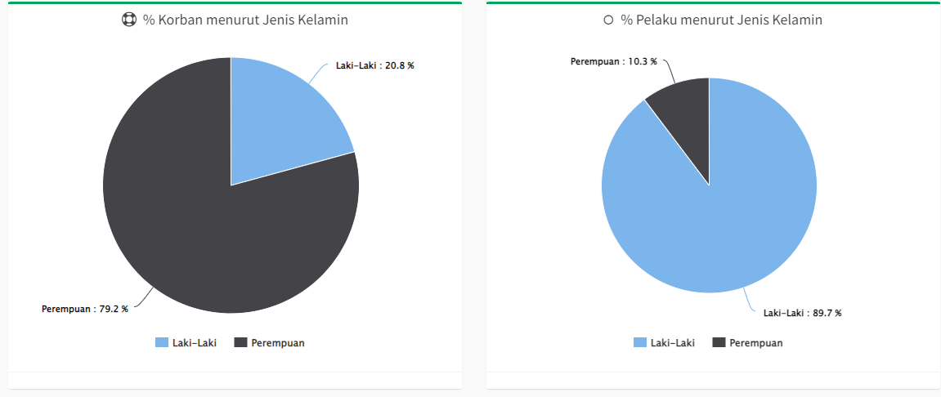
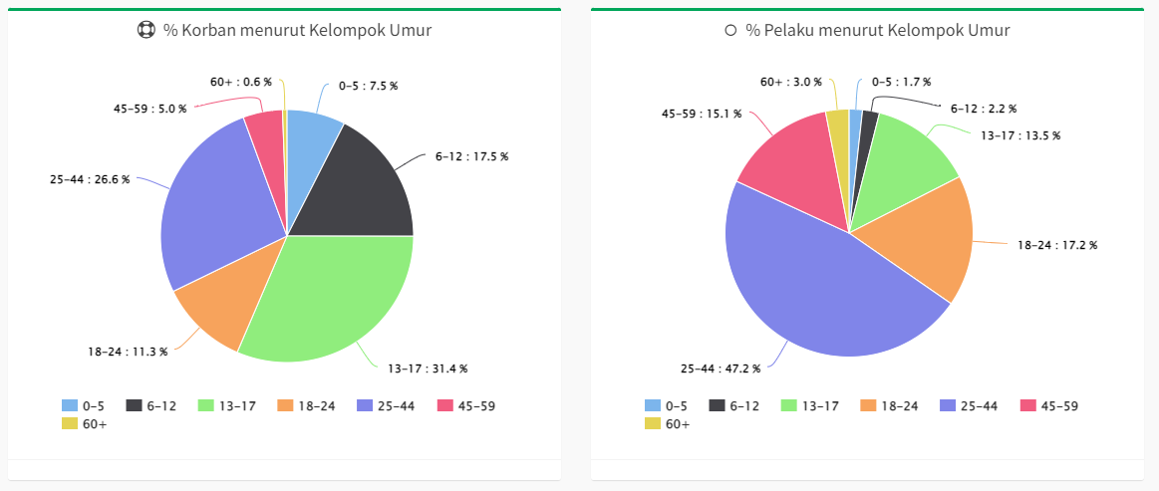
BACKGROUND
The results of a study from the research company Value Champion, Singapore in 2019 which stated that Indonesia was ranked second in the Asia Pacific, as a dangerous country for women.
Based on data from the Sistem Informasi Online Perlindungan Perempuan dan Anak (SIMFONI PPA) Kementerian Pemberdayaan Perempuan dan Perlindungan Anak of the Republic of Indonesia, on the data entered on January 1, 2022, there are currently around 9,764 cases including 1,533 for male victims and 9,052 for victims. woman.

Slide 4
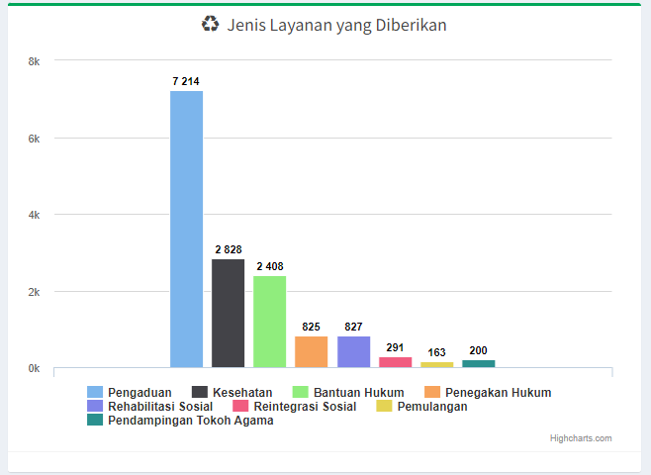
Based on information from Kementerian Pemberdayaan Perempuan dan Perlindungan Anak (Kemen PPPA), victims of violence can report through the Sahabat Perempuan dan Anak (SAPA) 129 call center service.
Source: https://kekerasan.kemenpppa.go.id/ringkasan

Slide 5
REASON
Overall, many people are not aware of the services provided by the government for complaints like this. The less than optimal socialization provided by the government resulted in a lack of enthusiasm from the community to use these services.
With the rapid development of technology in this era as well as the widespread problems of violence against women and children, our team focuses on creating a complaint service that is easily accessible by anyone at any time with attractive features and is also simple to use. Making the application has features such as forums to share experiences or events that have occurred to themselves or those closest to them in cases related to anonymous identity. In addition, there is also a feature to consult directly with the admin, if the case at hand is in an emergency stage, it will be forwarded to the authorities.
Making this application is expected to help the community in handling and resolving cases of violence and other cases.

Slide 6
EXISTING REASULT
01
02
03
SAPA 129
QUORA
W3C
This service has the same purpose, such as a complaint service for cases of violence against women and children. This service is only direct by being connected to the officer via telephone.
This application has the same features as the forum feature for questions and answers with free and unlimited cases. Users of this application can state their identity.
This application has a question and answer feature with a limited theme regarding the experience of violence or harassment. And in this application the user's identity is disguised.

Slide 7
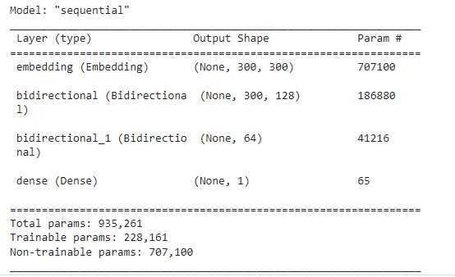
IMPLEMENTING
The dataset used is a twitter dataset taken from kaggle.com. The label used is abusive sentence. Sentences are divided into two classifications, namely positive sentences and negative sentences.

Slide 8
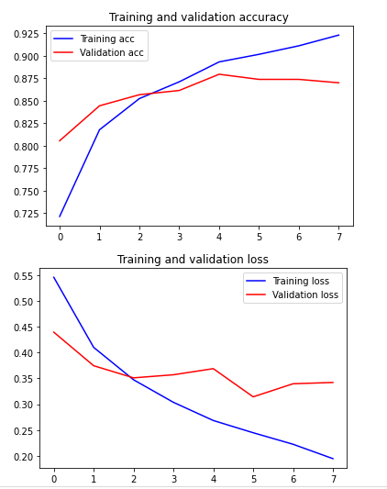
The accuracy of this model is 0.8712984323501587 or about 87%, while the loss is 0.34686481952667236 or 35%.
The average time step is 1s/step.

Slide 9
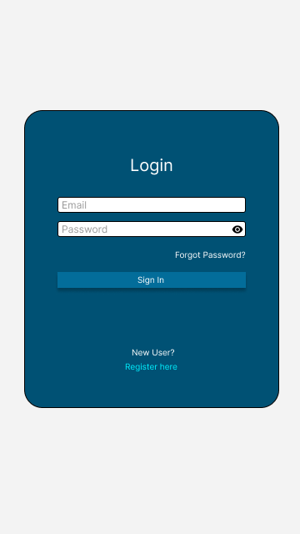
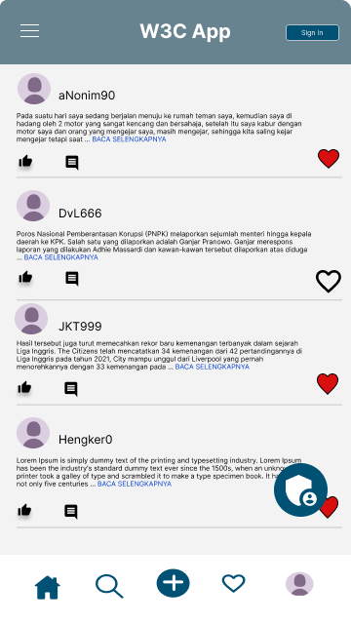
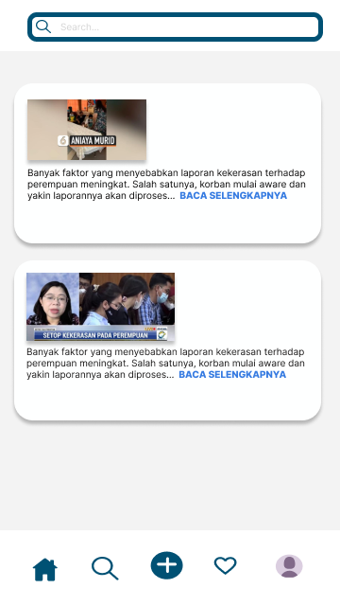
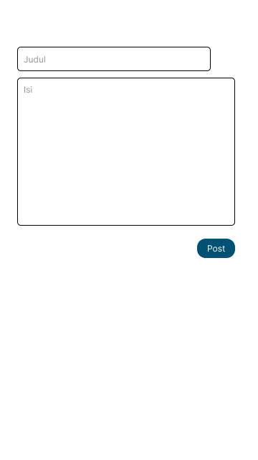
RESULT

Slide 10

DOCUMENTATION
Here are the links used in this presentation.
GitHub Repository:
https://github.com/danskun/Capstone.git

Slide 11

GO-TO MARKET PLAN
You can see the Go-To Market Plan in this link: Go-To Market Plan C22-PS071

Slide 12
Thank You……

